Slide 1
MATH-352 Numerical Methods
Atifa Kanwal
atifa.kanwal@seecs.edu.pk
Office # 303, Faculty Block, SEECS, NUST

Slide 2
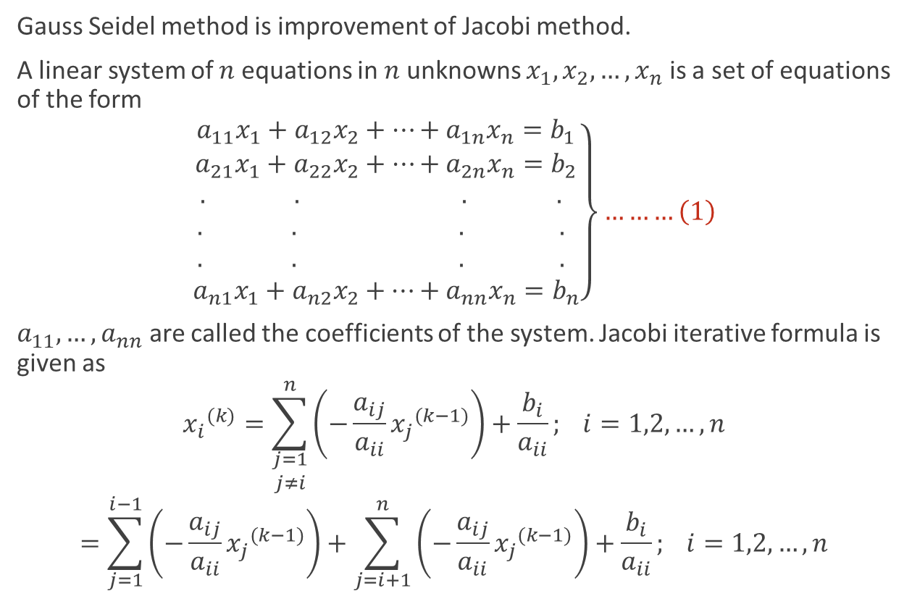
2.The Gauss Seidel Method
Gauss Seidel method is improvement of Jacobi method.
A linear system of $n$ equations in $n$ unknowns $x_{1},x_{2},…,x_{n}$ is a set of equations of the form
$$\left.\begin{aligned}a_{11}x_{1}+a_{12}x_{2}+…+a_{1n}x_{n}=b_{1} \\ a_{21}x_{1}+a_{22}x_{2}+…+a_{2n}x_{n}=b_{2} \\ . . . . \\ . . . . \\ . . . . \\ a_{n1}x_{1}+a_{n2}x_{2}+…+a_{nn}x_{n}=b_{n}\end{aligned}\right\}………\left(1\right)$$
$a_{11},…,a_{nn}$ are called the coefficients of the system. Jacobi iterative formula is given as
$${x_{i}}^{(k)}=\sum_{\begin{aligned}j=1 \\ j≠i\end{aligned}}^{n}{\left(−\frac{a_{ij}}{a_{ii}}{x_{j}}^{(k−1)}\right)}+\frac{b_{i}}{a_{ii}}; i=1,2,…,n$$
$$=\sum_{j=1}^{i−1}{\left(−\frac{a_{ij}}{a_{ii}}{x_{j}}^{(k−1)}\right)}+\sum_{j=i+1}^{n}{\left(−\frac{a_{ij}}{a_{ii}}{x_{j}}^{(k−1)}\right)}+\frac{b_{i}}{a_{ii}}; i=1,2,…,n$$

Slide 3
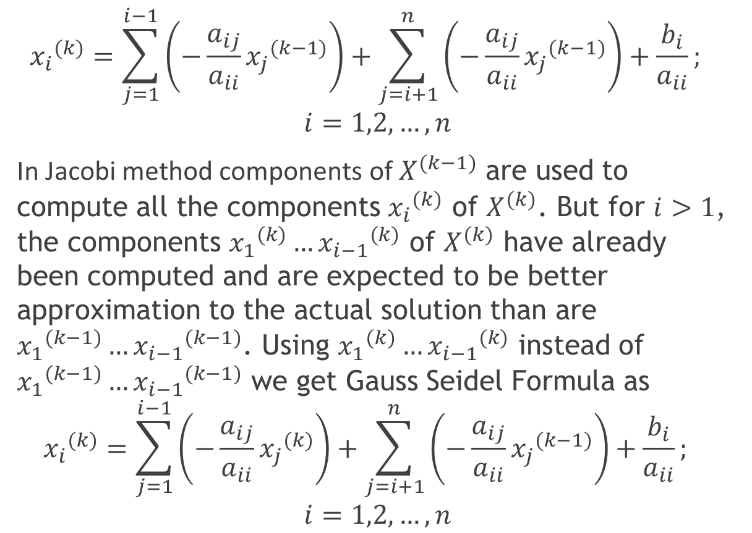
$${x_{i}}^{(k)}=\sum_{j=1}^{i−1}{\left(−\frac{a_{ij}}{a_{ii}}{x_{j}}^{(k−1)}\right)}+\sum_{j=i+1}^{n}{\left(−\frac{a_{ij}}{a_{ii}}{x_{j}}^{(k−1)}\right)}+\frac{b_{i}}{a_{ii}};$$
$$i=1,2,…,n$$
In Jacobi method components of $X^{(k−1)}$ are used to compute all the components ${x_{i}}^{(k)}$ of $X^{(k)}$. But for $i>1$, the components ${x_{1}}^{(k)}…{x_{i−1}}^{(k)}$ of $X^{(k)}$ have already been computed and are expected to be better approximation to the actual solution than are ${x_{1}}^{(k−1)}…{x_{i−1}}^{(k−1)}$. Using ${x_{1}}^{(k)}…{x_{i−1}}^{(k)}$ instead of ${x_{1}}^{(k−1)}…{x_{i−1}}^{(k−1)}$ we get Gauss Seidel Formula as
$${x_{i}}^{(k)}=\sum_{j=1}^{i−1}{\left(−\frac{a_{ij}}{a_{ii}}{x_{j}}^{(k)}\right)}+\sum_{j=i+1}^{n}{\left(−\frac{a_{ij}}{a_{ii}}{x_{j}}^{(k−1)}\right)}+\frac{b_{i}}{a_{ii}};$$
$$i=1,2,…,n$$

Slide 4
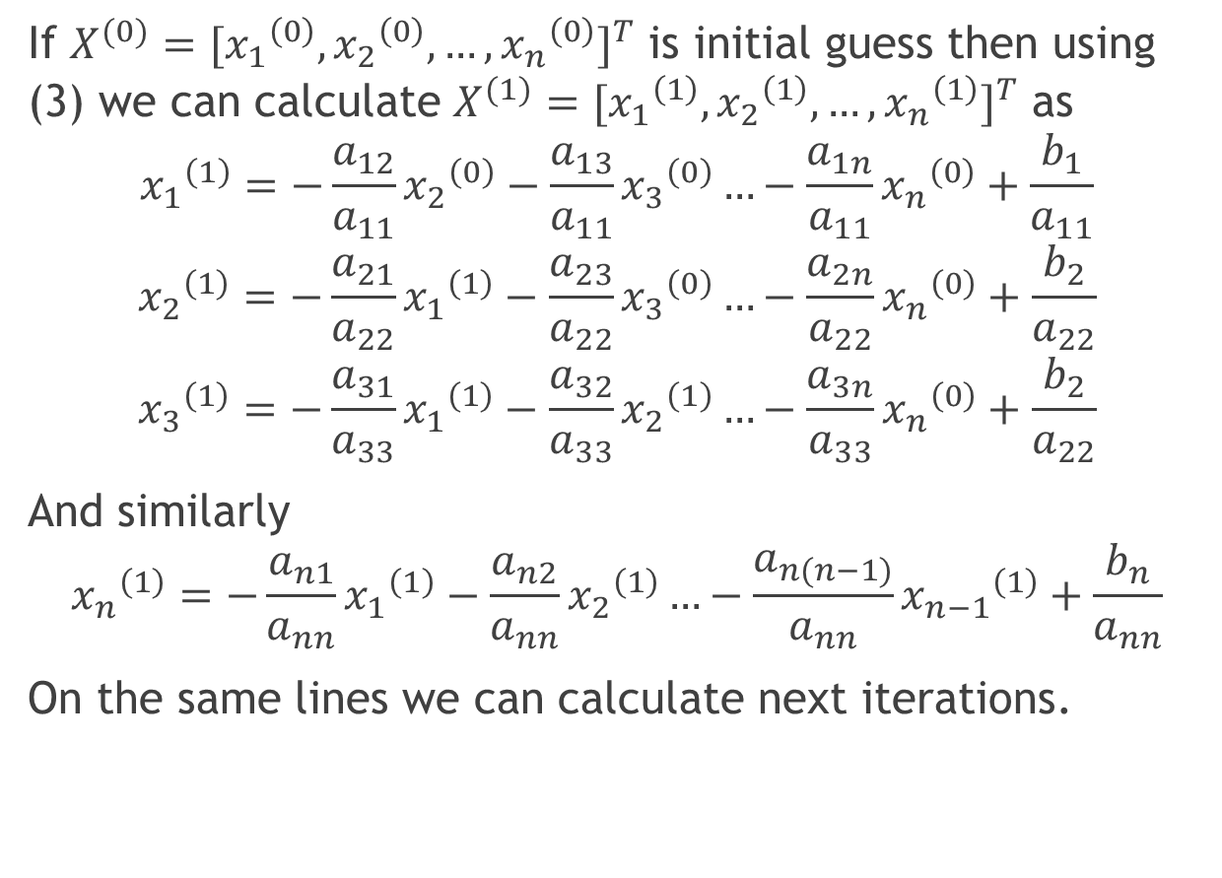
If $X^{(0)}{=[{x_{1}}^{\left(0\right)},{x_{2}}^{\left(0\right)},…,{x_{n}}^{\left(0\right)}]}^{T}$ is initial guess then using (3) we can calculate $X^{(1)}{=[{x_{1}}^{\left(1\right)},{x_{2}}^{\left(1\right)},…,{x_{n}}^{\left(1\right)}]}^{T}$ as
$${x_{1}}^{\left(1\right)}=−\frac{a_{12}}{a_{11}}{x_{2}}^{\left(0\right)}−\frac{a_{13}}{a_{11}}{x_{3}}^{\left(0\right)}…−\frac{a_{1n}}{a_{11}}{x_{n}}^{\left(0\right)}+\frac{b_{1}}{a_{11}}$$
$${x_{2}}^{\left(1\right)}=−\frac{a_{21}}{a_{22}}{x_{1}}^{\left(1\right)}−\frac{a_{23}}{a_{22}}{x_{3}}^{\left(0\right)}…−\frac{a_{2n}}{a_{22}}{x_{n}}^{\left(0\right)}+\frac{b_{2}}{a_{22}}$$
$${x_{3}}^{\left(1\right)}=−\frac{a_{31}}{a_{33}}{x_{1}}^{\left(1\right)}−\frac{a_{32}}{a_{33}}{x_{2}}^{\left(1\right)}…−\frac{a_{3n}}{a_{33}}{x_{n}}^{\left(0\right)}+\frac{b_{2}}{a_{22}}$$
And similarly
$${x_{n}}^{\left(1\right)}=−\frac{a_{n1}}{a_{nn}}{x_{1}}^{\left(1\right)}−\frac{a_{n2}}{a_{nn}}{x_{2}}^{\left(1\right)}…−\frac{a_{n(n−1)}}{a_{nn}}{x_{n−1}}^{\left(1\right)}+\frac{b_{n}}{a_{nn}}$$
On the same lines we can calculate next iterations.

Slide 5
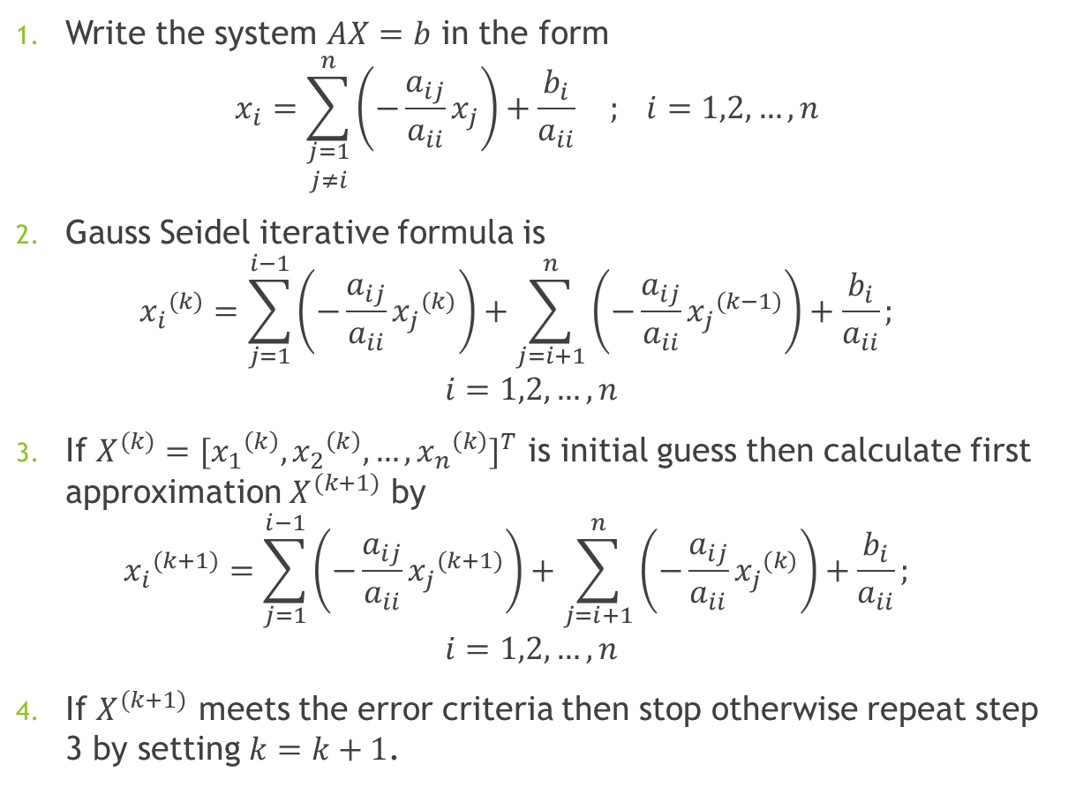
Algorithm
Write the system $AX=b$ in the form
$$x_{i}=\sum_{\begin{aligned}j=1 \\ j≠i\end{aligned}}^{n}{\left(−\frac{a_{ij}}{a_{ii}}x_{j}\right)}+\frac{b_{i}}{a_{ii}} ; i=1,2,…,n$$
Gauss Seidel iterative formula is
$${x_{i}}^{(k)}=\sum_{j=1}^{i−1}{\left(−\frac{a_{ij}}{a_{ii}}{x_{j}}^{(k)}\right)}+\sum_{j=i+1}^{n}{\left(−\frac{a_{ij}}{a_{ii}}{x_{j}}^{(k−1)}\right)}+\frac{b_{i}}{a_{ii}};$$
$$i=1,2,…,n$$
If $X^{(k)}{=[{x_{1}}^{\left(k\right)},{x_{2}}^{\left(k\right)},…,{x_{n}}^{\left(k\right)}]}^{T}$ is initial guess then calculate first approximation $X^{(k+1)}$ by
$${x_{i}}^{(k+1)}=\sum_{j=1}^{i−1}{\left(−\frac{a_{ij}}{a_{ii}}{x_{j}}^{(k+1)}\right)}+\sum_{j=i+1}^{n}{\left(−\frac{a_{ij}}{a_{ii}}{x_{j}}^{(k)}\right)}+\frac{b_{i}}{a_{ii}};$$
$$i=1,2,…,n$$
If $X^{(k+1)}$ meets the error criteria then stop otherwise repeat step 3 by setting $k=k+1$.

Slide 6
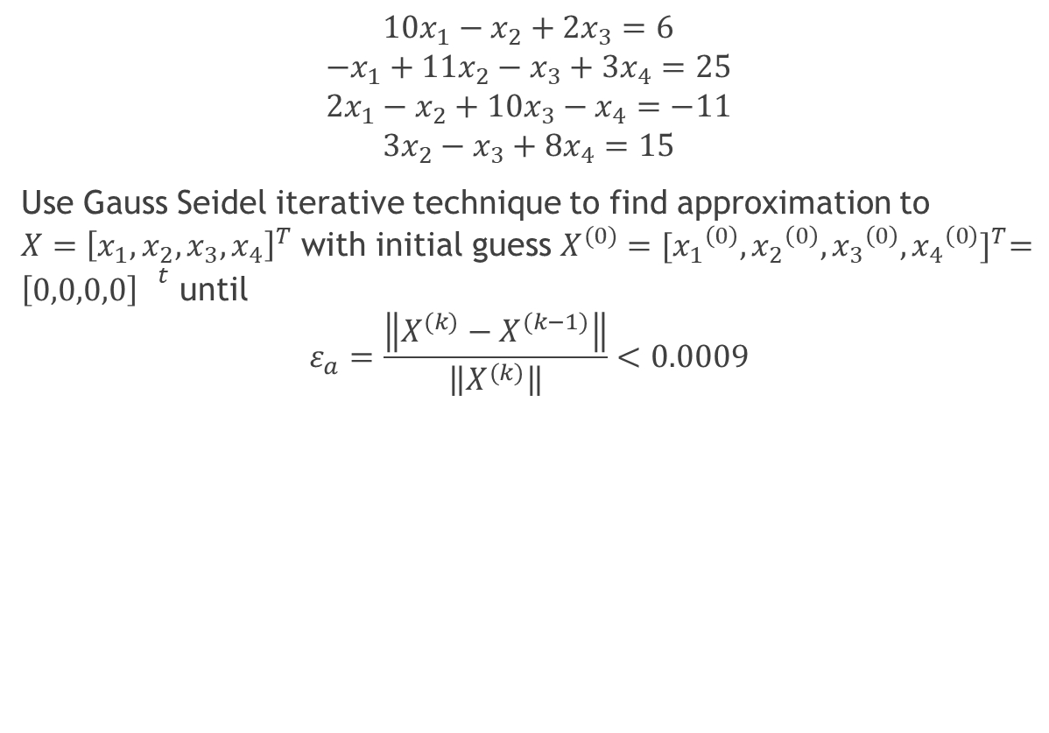
Example
$$10x_{1}−x_{2}+2x_{3}=6$$
$$−x_{1}+11x_{2}−x_{3}+3x_{4}=25$$
$$2x_{1}−x_{2}+10x_{3}−x_{4}=−11$$
$$3x_{2}−x_{3}+8x_{4}=15$$
Use Gauss Seidel iterative technique to find approximation to $X={\left[x_{1},x_{2},x_{3},x_{4}\right]}^{T}$ with initial guess $X^{(0)}{=[{x_{1}}^{\left(0\right)},{x_{2}}^{\left(0\right)},{x_{3}}^{\left(0\right)},{x_{4}}^{\left(0\right)}]}^{T}={\left[0,0,0,0\right] }^{t}$ until
$$ε_{a}=\frac{\left\|X^{(k)}−X^{(k−1)}\right\|}{\left\|X^{(k)}\right\|}<0.0009$$

Slide 7
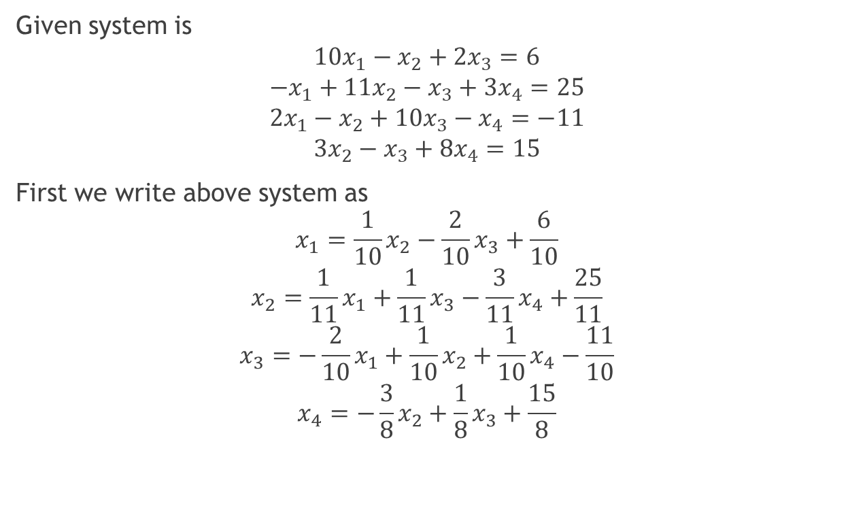
Solution
Given system is
$$10x_{1}−x_{2}+2x_{3}=6$$
$$−x_{1}+11x_{2}−x_{3}+3x_{4}=25$$
$$2x_{1}−x_{2}+10x_{3}−x_{4}=−11$$
$$3x_{2}−x_{3}+8x_{4}=15$$
First we write above system as
$$x_{1}=\frac{1}{10}x_{2}−\frac{2}{10}x_{3}+\frac{6}{10}$$
$$x_{2}=\frac{1}{11}x_{1}+\frac{1}{11}x_{3}−\frac{3}{11}x_{4}+\frac{25}{11}$$
$$x_{3}=−\frac{2}{10}x_{1}+\frac{1}{10}x_{2}+\frac{1}{10}x_{4}−\frac{11}{10}$$
$$x_{4}=−\frac{3}{8}x_{2}+\frac{1}{8}x_{3}+\frac{15}{8}$$
1st Eqn implies
2nd Eqn implies
3rd Eqn implies
4th Eqn implies

Slide 8
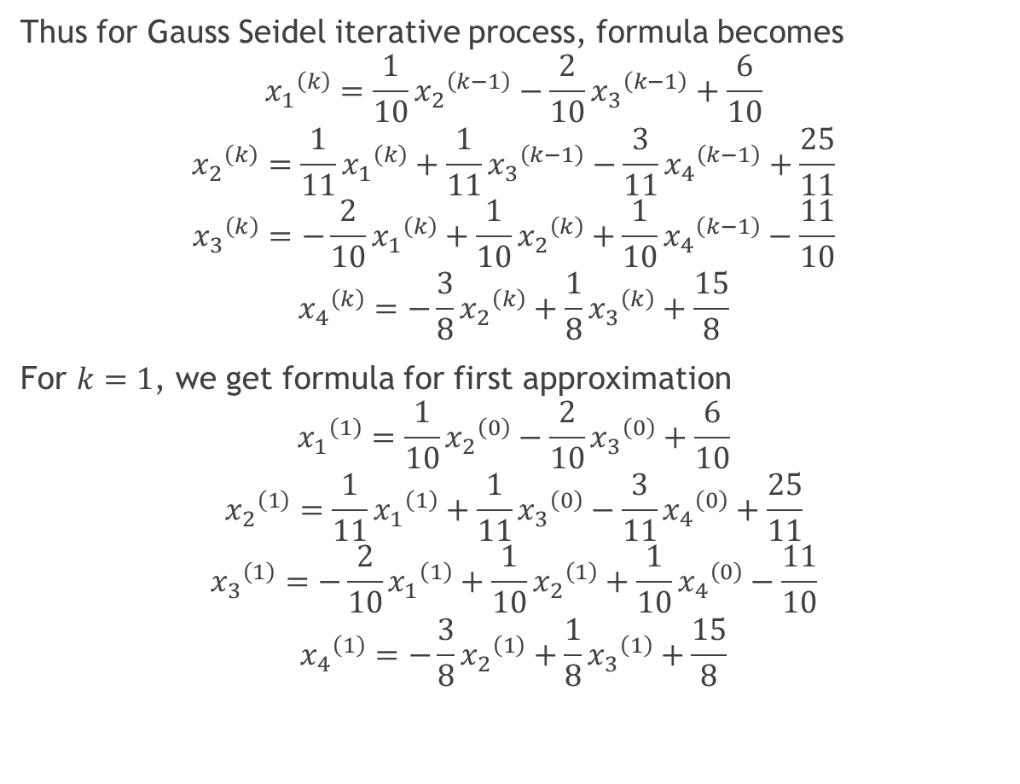
Thus for Gauss Seidel iterative process, formula becomes
$${x_{1}}^{\left(k\right)}=\frac{1}{10}{x_{2}}^{\left(k−1\right)}−\frac{2}{10}{x_{3}}^{\left(k−1\right)}+\frac{6}{10}$$
$${x_{2}}^{\left(k\right)}=\frac{1}{11}{x_{1}}^{\left(k\right)}+\frac{1}{11}{x_{3}}^{\left(k−1\right)}−\frac{3}{11}{x_{4}}^{\left(k−1\right)}+\frac{25}{11}$$
$${x_{3}}^{\left(k\right)}=−\frac{2}{10}{x_{1}}^{\left(k\right)}+\frac{1}{10}{x_{2}}^{\left(k\right)}+\frac{1}{10}{x_{4}}^{\left(k−1\right)}−\frac{11}{10}$$
$${x_{4}}^{\left(k\right)}=−\frac{3}{8}{x_{2}}^{\left(k\right)}+\frac{1}{8}{x_{3}}^{\left(k\right)}+\frac{15}{8}$$
For $k=1$, we get formula for first approximation
$${x_{1}}^{\left(1\right)}=\frac{1}{10}{x_{2}}^{\left(0\right)}−\frac{2}{10}{x_{3}}^{\left(0\right)}+\frac{6}{10}$$
$${x_{2}}^{\left(1\right)}=\frac{1}{11}{x_{1}}^{\left(1\right)}+\frac{1}{11}{x_{3}}^{\left(0\right)}−\frac{3}{11}{x_{4}}^{\left(0\right)}+\frac{25}{11}$$
$${x_{3}}^{\left(1\right)}=−\frac{2}{10}{x_{1}}^{\left(1\right)}+\frac{1}{10}{x_{2}}^{\left(1\right)}+\frac{1}{10}{x_{4}}^{\left(0\right)}−\frac{11}{10}$$
$${x_{4}}^{\left(1\right)}=−\frac{3}{8}{x_{2}}^{\left(1\right)}+\frac{1}{8}{x_{3}}^{\left(1\right)}+\frac{15}{8}$$

Slide 9
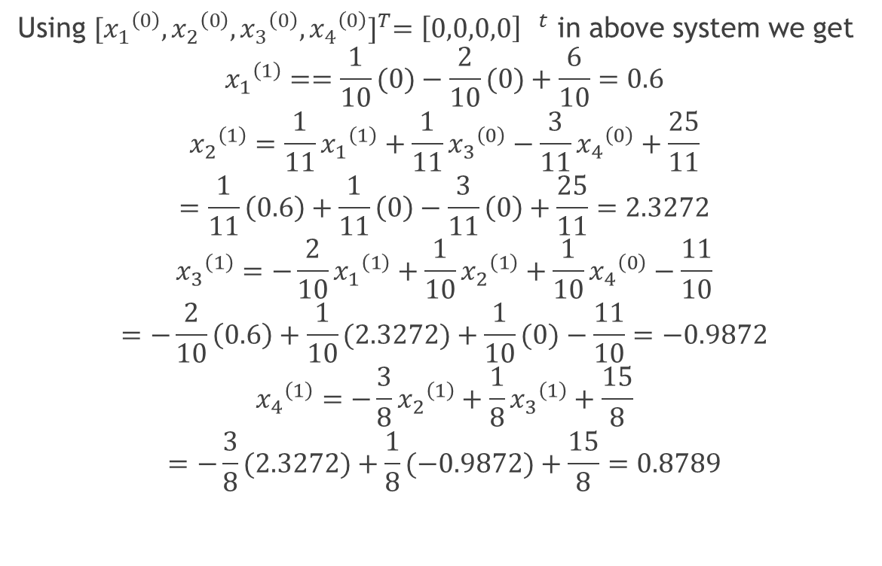
Using ${[{x_{1}}^{\left(0\right)},{x_{2}}^{\left(0\right)},{x_{3}}^{\left(0\right)},{x_{4}}^{\left(0\right)}]}^{T}={\left[0,0,0,0\right] }^{t}$ in above system we get
$${x_{1}}^{\left(1\right)}==\frac{1}{10}(0)−\frac{2}{10}(0)+\frac{6}{10}=0.6$$
$${x_{2}}^{\left(1\right)}=\frac{1}{11}{x_{1}}^{\left(1\right)}+\frac{1}{11}{x_{3}}^{\left(0\right)}−\frac{3}{11}{x_{4}}^{\left(0\right)}+\frac{25}{11}$$
$$=\frac{1}{11}\left(0.6\right)+\frac{1}{11}\left(0\right)−\frac{3}{11}\left(0\right)+\frac{25}{11}=2.3272$$
$${x_{3}}^{\left(1\right)}=−\frac{2}{10}{x_{1}}^{\left(1\right)}+\frac{1}{10}{x_{2}}^{\left(1\right)}+\frac{1}{10}{x_{4}}^{\left(0\right)}−\frac{11}{10}$$
$$=−\frac{2}{10}\left(0.6\right)+\frac{1}{10}(2.3272)+\frac{1}{10}(0)−\frac{11}{10}=−0.9872$$
$${x_{4}}^{\left(1\right)}=−\frac{3}{8}{x_{2}}^{\left(1\right)}+\frac{1}{8}{x_{3}}^{\left(1\right)}+\frac{15}{8}$$
$$=−\frac{3}{8}(2.3272)+\frac{1}{8}(−0.9872)+\frac{15}{8}=0.8789$$

Slide 10
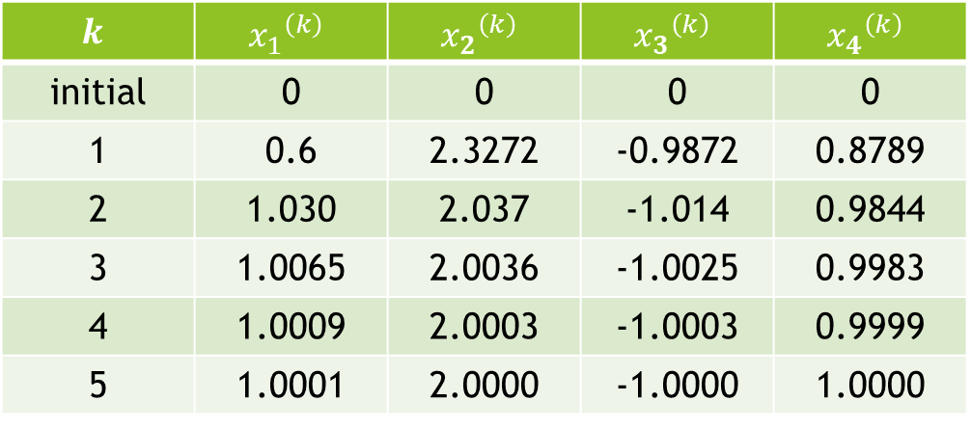
We can perform iteration in a table
$$k$$ | $${x_{1}}^{\left(k\right)}$$ | $${x_{2}}^{\left(k\right)}$$ | $${x_{3}}^{\left(k\right)}$$ | $${x_{4}}^{\left(k\right)}$$
initial | 0 | 0 | 0 | 0
1 | 0.6 | 2.3272 | -0.9872 | 0.8789
2 | 1.030 | 2.037 | -1.014 | 0.9844
3 | 1.0065 | 2.0036 | -1.0025 | 0.9983
4 | 1.0009 | 2.0003 | -1.0003 | 0.9999
5 | 1.0001 | 2.0000 | -1.0000 | 1.0000

Slide 11
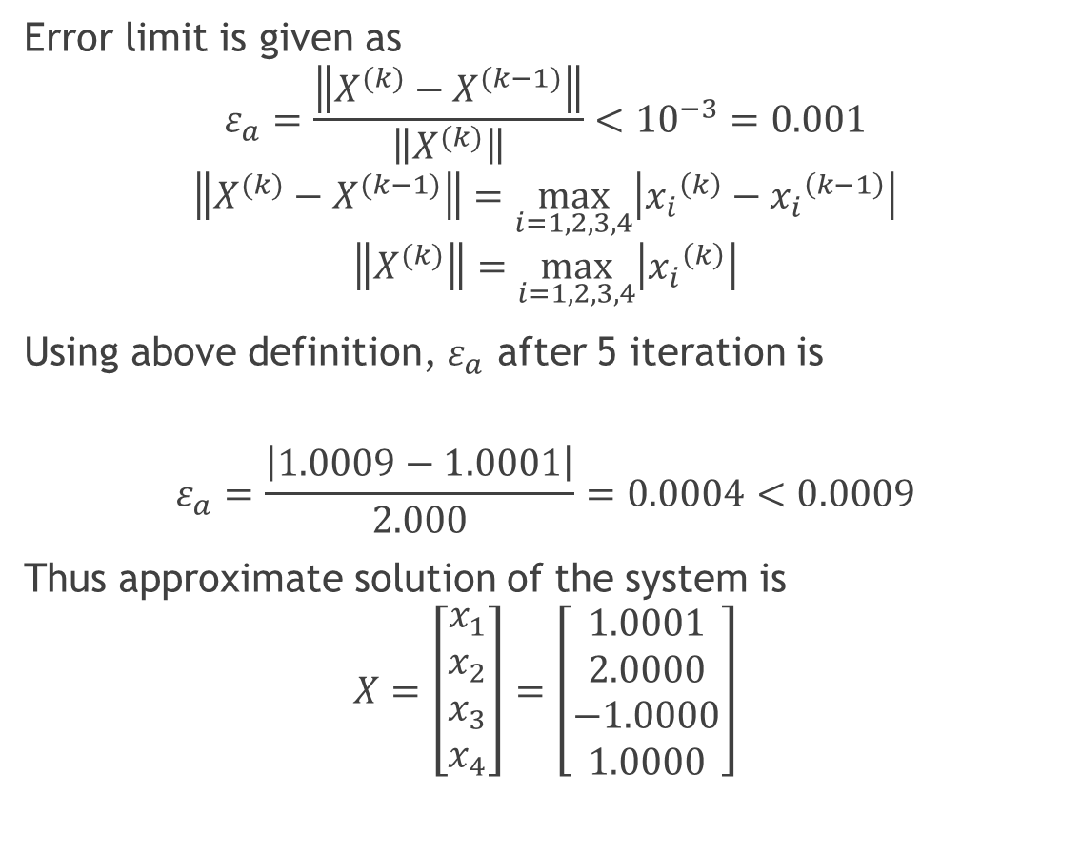
Error limit is given as
$$ε_{a}=\frac{\left\|X^{(k)}−X^{(k−1)}\right\|}{\left\|X^{(k)}\right\|}<{10}^{−3}=0.001$$
$$\left\|X^{(k)}−X^{(k−1)}\right\|=\max_{i=1,2,3,4}\left|{x_{i}}^{\left(k\right)}−{x_{i}}^{\left(k−1\right)}\right|$$
$$\left\|X^{(k)}\right\|=\max_{i=1,2,3,4}\left|{x_{i}}^{\left(k\right)}\right|$$
Using above definition, $ε_{a}$ after 5 iteration is
$$ε_{a}=\frac{\left|1.0009−1.0001\right|}{2.000}=0.0004<0.0009$$
Thus approximate solution of the system is
$$X=\left[\begin{aligned}x_{1} \\ x_{2} \\ x_{3} \\ x_{4}\end{aligned}\right]=\left[\begin{aligned}1.0001 \\ 2.0000 \\ −1.0000 \\ 1.0000\end{aligned}\right]$$

Slide 12

Comparison with Jacobi Method
Jacobi Method:
After 6 iteration $ε_{a}=0.00963>0.0009$
Gauss Seidel Method:
After 5 iteration $ε_{a}=0.0004<0.0009$

Slide 13
Diagonally Dominant Matrix
In Jacobi and Gauss Seidel method, we can construct iterative formula using different arrangement of equations.
BUT
will iterative process converges to solution in each case?

Slide 14
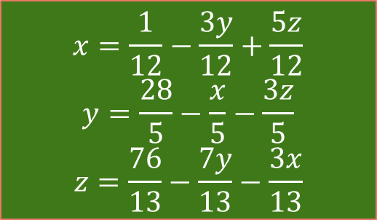
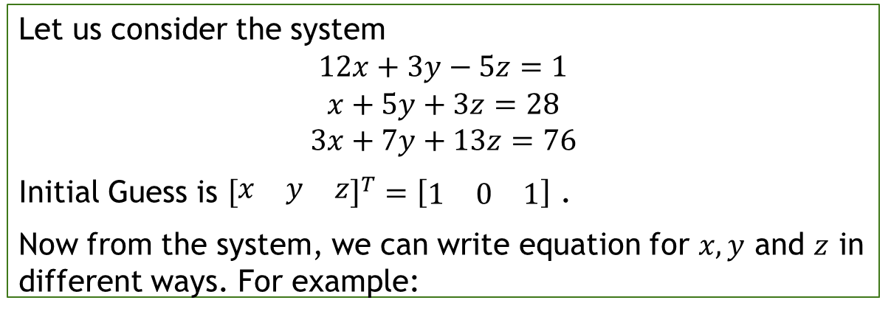
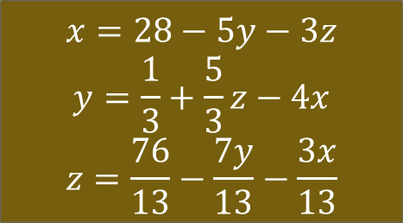
Let us consider an example:
Let us consider the system
$$12x+3y−5z=1$$
$$x+5y+3z=28$$
$$3x+7y+13z=76$$
Initial Guess is ${\left[\begin{matrix}x & y & z\end{matrix}\right]}^{T}=\left[\begin{matrix}1 & 0 & 1\end{matrix}\right]$ .
Now from the system, we can write equation for $x,y$ and $z$ in different ways. For example:
Option (a)
Option (b)
$$x=\frac{1}{12}−\frac{3y}{12}+\frac{5z}{12}$$
$$y=\frac{28}{5}−\frac{x}{5}−\frac{3z}{5}$$
$$z=\frac{76}{13}−\frac{7y}{13}−\frac{3x}{13}$$
$$x=28−5y−3z$$
$$y=\frac{1}{3}+\frac{5}{3}z−4x$$
$$z=\frac{76}{13}−\frac{7y}{13}−\frac{3x}{13}$$

Slide 15
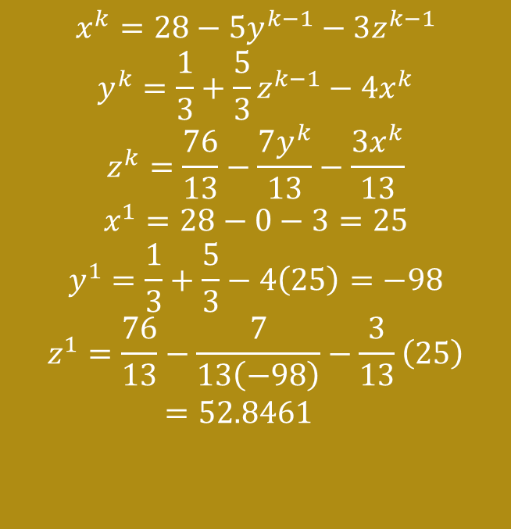
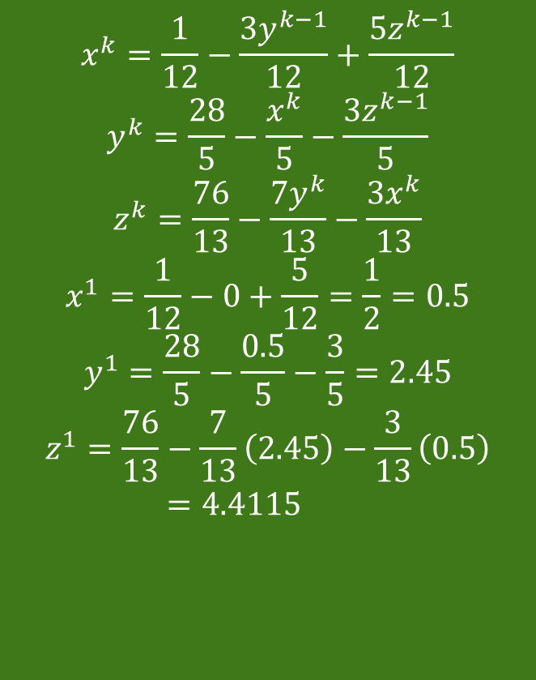
Option (a)
Option (b)
$$x^{k}=\frac{1}{12}−\frac{3y^{k−1}}{12}+\frac{5z^{k−1}}{12}$$
$$y^{k}=\frac{28}{5}−\frac{x^{k}}{5}−\frac{3z^{k−1}}{5}$$
$$z^{k}=\frac{76}{13}−\frac{7y^{k}}{13}−\frac{3x^{k}}{13}$$
$$x^{1}=\frac{1}{12}−0+\frac{5}{12}=\frac{1}{2}=0.5$$
$$y^{1}=\frac{28}{5}−\frac{0.5}{5}−\frac{3}{5}=2.45$$
$$z^{1}=\frac{76}{13}−\frac{7}{13}\left(2.45\right)−\frac{3}{13}\left(0.5\right)=4.4115$$
$$x^{k}=28−5y^{k−1}−3z^{k−1}$$
$$y^{k}=\frac{1}{3}+\frac{5}{3}z^{k−1}−4x^{k}$$
$$z^{k}=\frac{76}{13}−\frac{7y^{k}}{13}−\frac{3x^{k}}{13}$$
$$x^{1}=28−0−3=25$$
$$y^{1}=\frac{1}{3}+\frac{5}{3}−4\left(25\right)=−98$$
$$z^{1}=\frac{76}{13}−\frac{7}{13\left(−98\right)}−\frac{3}{13}\left(25\right)=52.8461$$

Slide 16
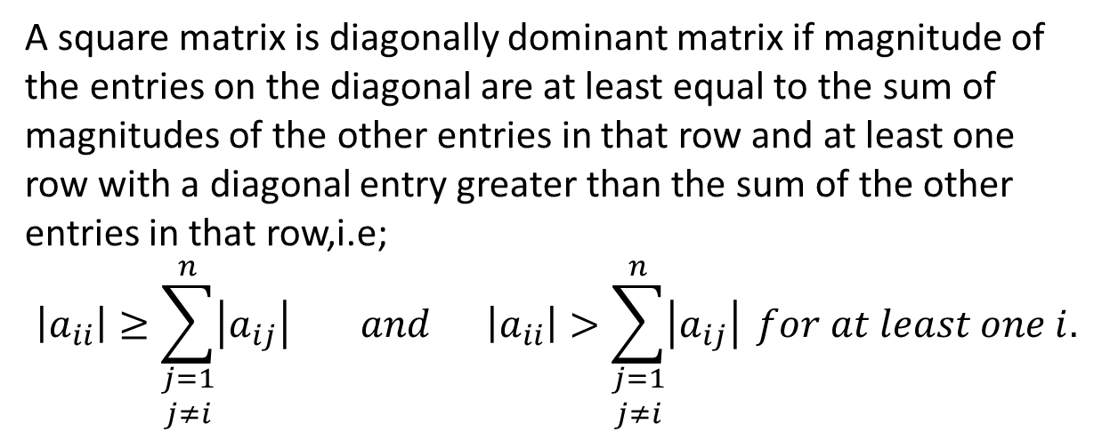
Thus we obtain different answers from option (a) and (b).
Gauss Seidel Convergence theorem tell us about, which iterative formula is convergent.
For that we need to define diagonally dominant matrix.
Diagonally Dominant Matrix
A square matrix is diagonally dominant matrix if magnitude of the entries on the diagonal are at least equal to the sum of magnitudes of the other entries in that row and at least one row with a diagonal entry greater than the sum of the other entries in that row,i.e;
$$\left|a_{ii}\right|≥\sum_{\begin{aligned}j=1 \\ j≠i\end{aligned}}^{n}{\left|a_{ij}\right|} and \left|a_{ii}\right|>\sum_{\begin{aligned}j=1 \\ j≠i\end{aligned}}^{n}{\left|a_{ij}\right|} for at least one i.$$

Slide 17


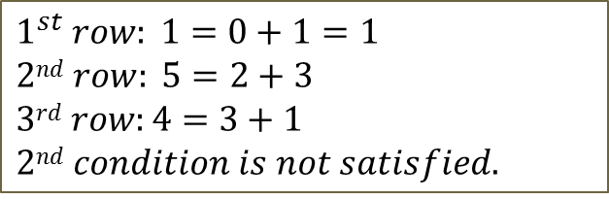

Examples
1. $A=\left[\begin{matrix}1 & 0 & −1 \\ 2 & 5 & 1 \\ 1 & 1 & 4\end{matrix}\right]$; diagonally dominant.
2. $A=\left[\begin{matrix}1 & 0 & −1 \\ 2 & 5 & 1 \\ 1 & 1 & 1\end{matrix}\right]$, not diagonally dominant matrix
3. $A=\left[\begin{matrix}1 & 0 & −1 \\ 2 & 5 & 3 \\ 1 & 3 & 4\end{matrix}\right]$; not diagonally dominant
$1st row: 1=0+1$
$2nd row: 5>2+1=3$
$3rd row: 4>1+1=2$
$$3rd row:1<1+1=2$$
$1^{st} row: 1=0+1=1$
$2nd row: 5=2+3$
$3rd row:4=3+1$
$2nd condition is not satisfied.$

Slide 18

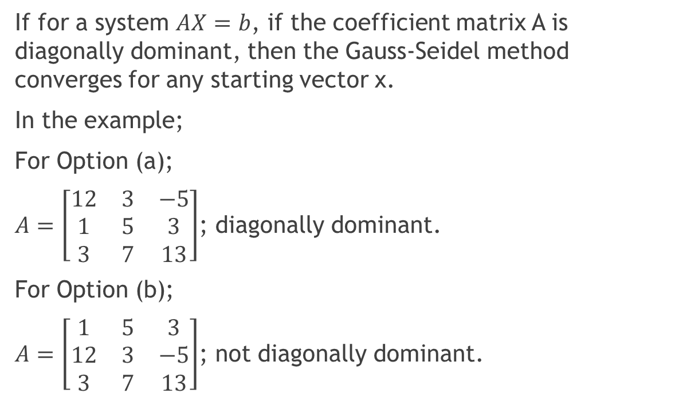
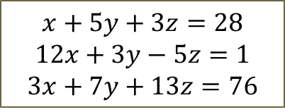
Gauss Seidel Convergence Theorem
If for a system $AX=b$, if the coefficient matrix A is diagonally dominant, then the Gauss-Seidel method converges for any starting vector x.
In the example;
For Option (a);
$A=\left[\begin{matrix}12 & 3 & −5 \\ 1 & 5 & 3 \\ 3 & 7 & 13\end{matrix}\right]$; diagonally dominant.
For Option (b);
$A=\left[\begin{matrix}1 & 5 & 3 \\ 12 & 3 & −5 \\ 3 & 7 & 13\end{matrix}\right]$; not diagonally dominant.
$$12x+3y−5z=1$$
$$x+5y+3z=28$$
$$3x+7y+13z=76$$
$$x+5y+3z=28$$
$$12x+3y−5z=1$$
$$3x+7y+13z=76$$

Slide 19
Thus Method converges in the case of option (a) but diverges for option(b).
Thus we should rearrange/shuffle equation in a system such that coefficient matrix remains diagonally dominant.

